Slide 1


Sebastián Caicedo
January 7th of 2025

Slide 2

Outline
Executive Summary
Introduction
Methodology
Results
Conclusion
Appendix

Slide 3
Executive Summary
We employed a systematic approach to tackle the problem. Data acquisition was performed through APIs, web scraping, and SQL queries, ensuring a robust dataset. After extensive data wrangling and exploratory analysis, machine learning models were built to predict first-stage landing success. Additionally, visualizations and interactive dashboards allowed to explore key insights.
This analysis yielded a high-accuracy prediction model for Falcon 9 first-stage landing success, identifying payload mass and launch site as critical factors. Insights from the project highlighted opportunities to optimize mission costs and gain a competitive edge. The interactive dashboard further provided stakeholders with a user-friendly tool to visualize results and test scenarios, enhancing decision-making capabilities.

Slide 4
Introduction
Project background and context
The space industry is becoming increasingly competitive, with companies like SpaceX driving down the cost of orbital missions through innovative engineering and operational strategies. For a new player in this market, understanding the factors that influence mission costs is crucial to competing effectively. This project focuses on SpaceX's Falcon 9 rocket, where a key determinant of mission cost is whether the first stage successfully lands. By leveraging SpaceX's historical data, we aim to uncover insights and provide actionable recommendations for cost optimization
What factors significantly impact the success of the Falcon 9 first-stage landing?
How does landing success influence the overall cost of a mission?
Can we build a predictive model to estimate the likelihood of a successful first-stage landing?
What insights can we provide to help a new competitor design a cost-efficient space mission strategy?

Slide 5

Section 1

Slide 6
Methodology
Executive Summary
Data collection methodology:
Web scraping
SpaceX API for data collection
Perform data wrangling
Null values were handled, Occurrency of launches per Sites, orbits, new sets were created wth new features and class for determining success rate.
Perform exploratory data analysis (EDA) using visualization and SQL
Perform interactive visual analytics using Folium and Plotly Dash
Perform predictive analysis using classification models
How to build, tune, evaluate classification models

Slide 7
Data Collection
Data was collected using data from SpaceX data API, retrieving and creating datasets with different characteristics relevant for the project as
'rocket', 'payloads', 'launchpad', 'cores', 'flight_number', 'date_utc’
Web scrapping was also used to retrieve data from Wikipedia using SQL, several key data was used including only falcon 9 launches

Slide 8
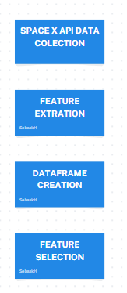
Data Collection – SpaceX API
API Request
Features Extraction
Dataframe creation
Fetaure selection and filter
Data wrangling
GitHub URL of the completed SpaceX API calls notebook.

Slide 9
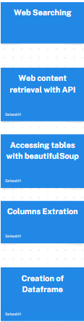
Data Collection - Scraping
Web Searching
Web content retrieval with API
Accessing tables with beautifulSoup
Columns Extration
Creation of Dataframe
GitHub URL of the completed web scraping notebook.

Slide 10
Data Wrangling
Exploratory Data Analysis
Handling of null values
Calculations of number of launches and occurrence
Creation of landing outcome label
Calculation of success rate
GitHub URL of completed data wrangling related notebooks.

Slide 11
EDA with Data Visualization
Scatter plots
This Visualization was used to see the relationship between different features and find patterns for success and failure of landings
Bar plots
This bar plots were used which orbits had the highest success rate
Line plots
Used to see how success rate had perfomed during time from 2010 to 2020
GitHub URL of completed EDA with data visualization notebook.

Slide 12
EDA with SQL
SQL queries performed:
select distinct "Launch_Site" from SPACEXTABLE
select * from SPACEXTABLE WHERE "Launch_Site" LIKE 'CCA%' LIMIT 5
SELECT SUM(PAYLOAD_MASS__KG_) from SPACEXTABLE where Customer = 'NASA (CRS)' group by Customer
SELECT AVG(PAYLOAD_MASS__KG_) FROM SPACEXTABLE WHERE Booster_Version = 'F9 v1.1’
SELECT min(DATE) FROM SPACEXTABLE WHERE Landing_Outcome like '%ground%' and Mission_Outcome = 'Success’
SELECT DISTINCT Booster_Version FROM SPACEXTABLE WHERE PAYLOAD_MASS__KG_ BETWEEN 4000 AND 6000 AND Landing_Outcome like '%drone%' and Mission_Outcome = 'Success’
select Mission_Outcome, count(*) from SPACEXTABLE group by Mission_Outcome
SELECT DISTINCT Booster_Version from spacextable where PAYLOAD_MASS__KG_ = (select max(PAYLOAD_MASS__KG_) from spacextable)
SELECT strftime('%m', Date) AS Month, Landing_Outcome, Booster_Version, Launch_Site
FROM SPACEXTABLE
WHERE strftime('%Y', Date) = '2015' and Landing_Outcome like '%drone%’ ;
select Date, Landing_Outcome, count(*) as outcome_count from spacextable where Date between '2010-06-04' and '2017-03-20' group by Landing_Outcome ORDER BY outcome_count DESC;
GitHub URL of completed EDA with SQL notebook.

Slide 13
Build an Interactive Map with Folium
Objects Added to Folium map:
Circles, Markers, Lines, Clusters
Those objects were added to identify the position of the launch sites, and clusters to see how many launches there are per each site, lines were added to show the distance between launch sites and areas such as railways, coasts cities etc.
GitHub URL of completed interactive map with Folium map.

Slide 14
Build a Dashboard with Plotly Dash
Summary of plots/graphs and interactions added to a dashboard:
Pie charts
Scatter plots
Pie charts allow us to see the proportion of success rate per launch site, and the comparing them each other.
Scatter plots allows us to see the relationship between payload mass and success rate for all version models been able to filter in a specific range of payloadmass
GitHub URL of your Plotly Dash lab.

Slide 15
Predictive Analysis (Classification)
4 Different Machine learning models were developed using gridsearch to find the best parameters for each model, comparing the best result of each model so that we could decide the model who best performed for this case.
Load dataset, Normalize, One hot encoding, Convert to Numpy arrays
Split data into training and testing sets
Creation of models: Logistic regression, Decision trees, SVM, KNN
Evaluation of models with test data, accuracy and Confusion matrices
GitHub URL of completed predictive analysis lab.

Slide 16
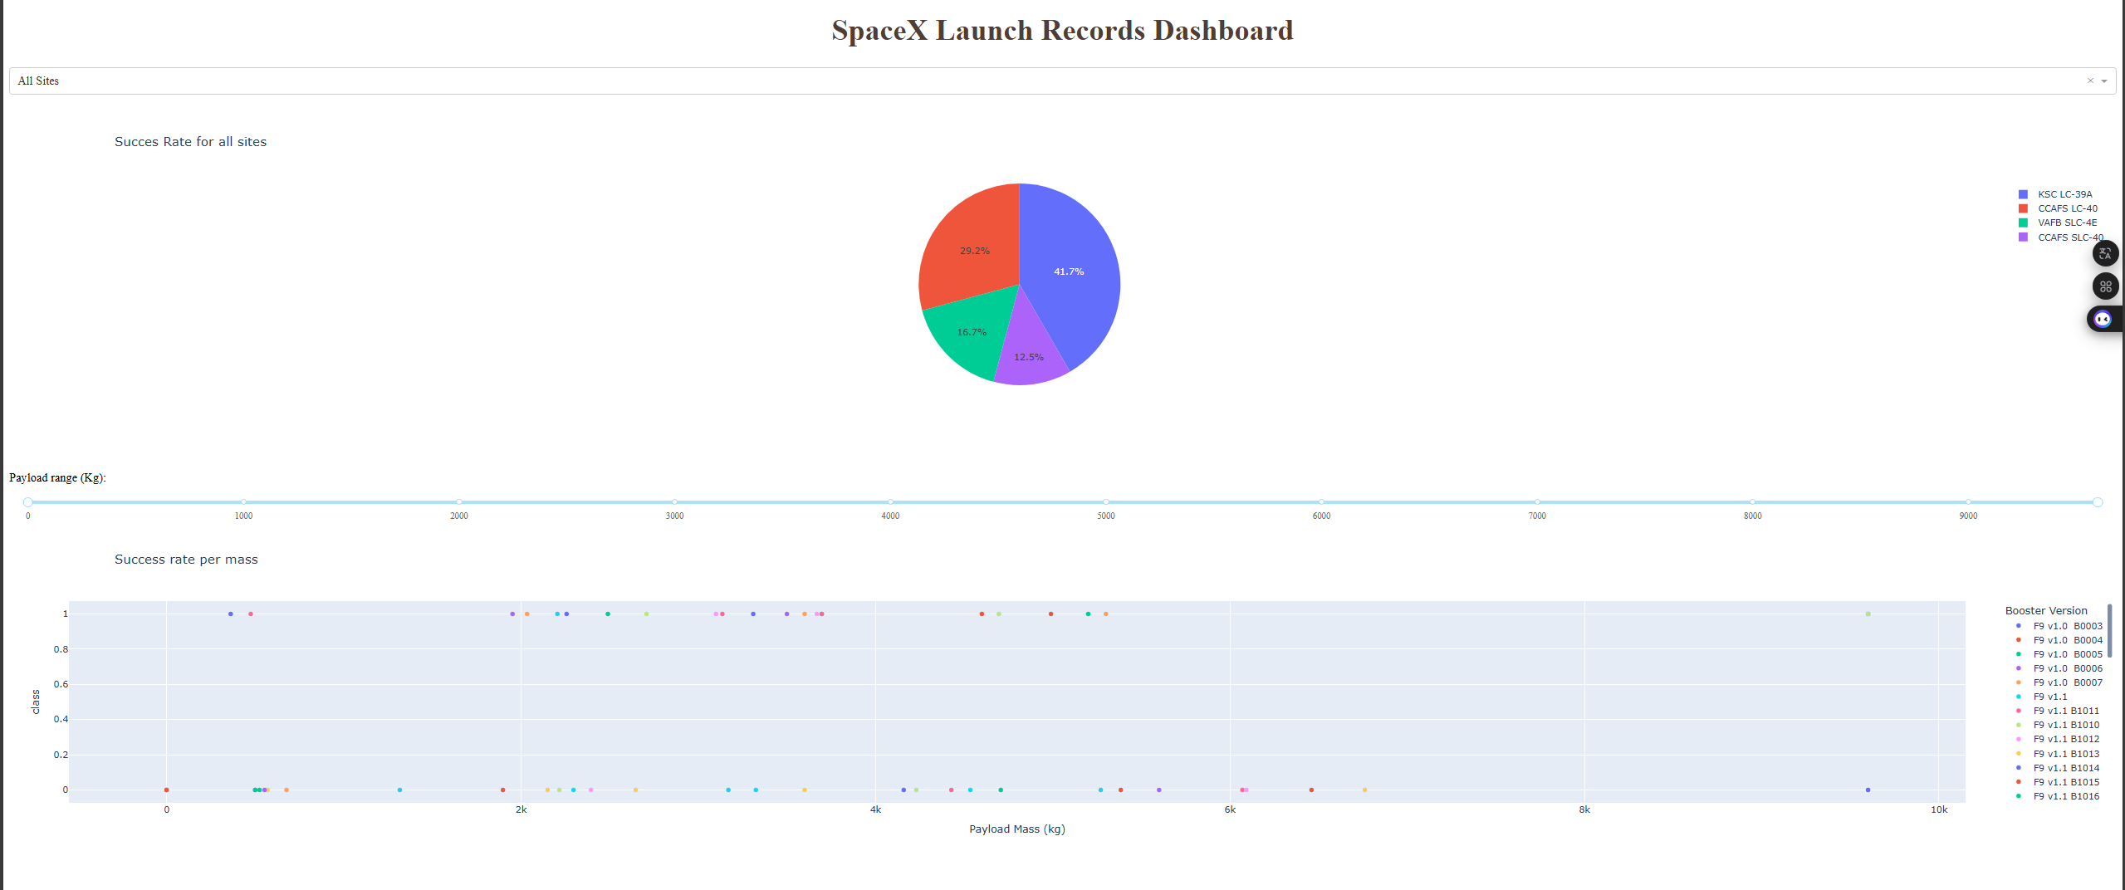
Results
Exploratory data analysis results: Important features: LauchSite, Paylaodmass, Version of booter,
Predictive analysis results:
Decision tree was selected as the best model achieving an accuracy in test data of 83,33% and training data of 90%

Slide 17

Section 2

Slide 18
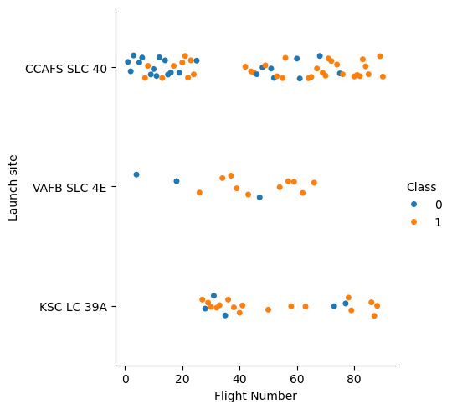
Flight Number vs. Launch Site
This graph show the relation between Fliht Number and Launch sites
It show that for more lunches performed the probability of a success launch is higher

Slide 19
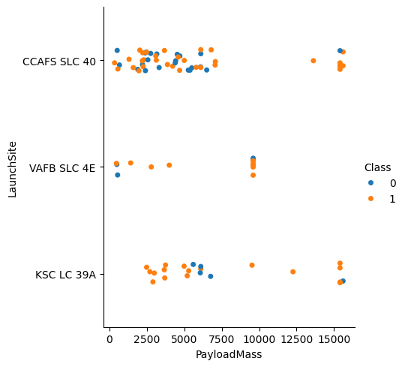
Payload vs. Launch Site
This graph show the relation between PayloadMass and Launch sites
It shows non correlation between PayloadMass and CCAFS site in the range of 0 to 7500kg
In general there’s no a direct relation of success between PayloadMass and LaunchSite

Slide 20
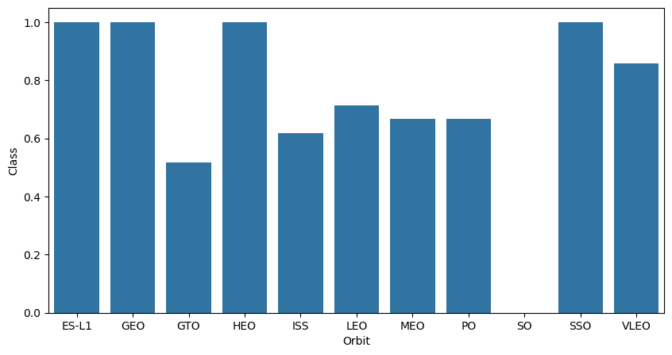
Success Rate vs. Orbit Type
This bar chart shows the Success rate for each Orbit
The highest success rate are for orbits ES-L1, GEO, HEO, and SSO
The lower success rate is for orbit SO

Slide 21
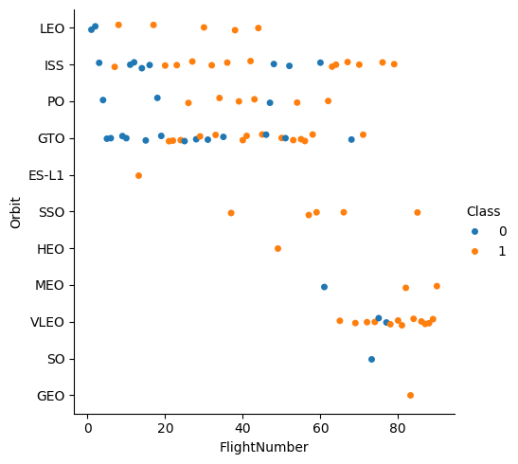
Flight Number vs. Orbit Type
This scatter plot show that at first no Launches were performed for some orbits.
For orbit GTO theres no relation between Flight Number and Orbit for Success rate,
LEO Orbit shows a better relation ship between this two characteristics
In General we can see the relation for this two variables depends on the Orbit

Slide 22
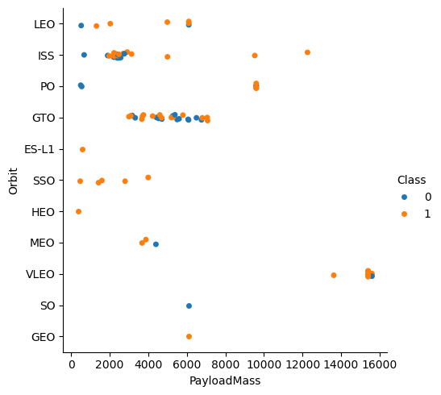
Payload vs. Orbit Type
Show a scatter point of payload vs. orbit type
Theres no much relation between PayloadMass and Orbit for success rate, specially for GTO

Slide 23
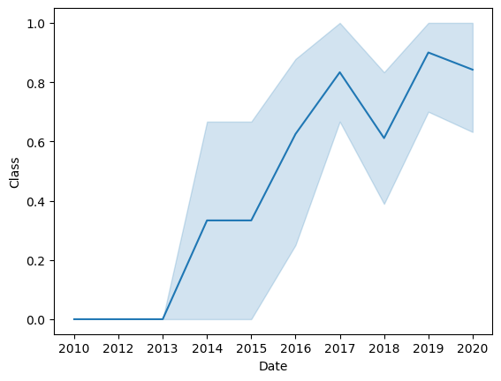
Launch Success Yearly Trend
Show a line chart of yearly average success rate
It’s seen that success rate have been increasing during years

Slide 24
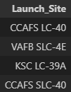
All Launch Site Names
Find the names of the unique launch
This are the Launch sites retrieved from the data.
select distinct "Launch_Site" from SPACEXTABLE

Slide 25
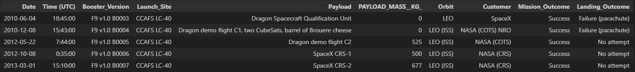
Launch Site Names Begin with 'CCA'
Find 5 records where launch sites begin with `CCA`
select * from SPACEXTABLE WHERE "Launch_Site" LIKE 'CCA%' LIMIT 5
We can see 5 reports of data where Launch site starts with ‘CCA’

Slide 26
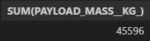
Total Payload Mass
Calculate the total payload carried by boosters from NASA
SELECT SUM(PAYLOAD_MASS__KG_) from SPACEXTABLE where Customer = 'NASA (CRS)' group by Custome
Total payload carried by all booster for NASA (CRS) is 45,596 kg

Slide 27
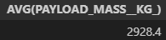
Average Payload Mass by F9 v1.1
Calculate the average payload mass carried by booster version F9 v1.1
SELECT AVG(PAYLOAD_MASS__KG_) FROM SPACEXTABLE WHERE Booster_Version = 'F9 v1.1’
2,928 kg is the averga PayloadMass carried by booster version F9 V1,1

Slide 28

First Successful Ground Landing Date
Find the dates of the first successful landing outcome on ground pad
SELECT min(DATE) FROM SPACEXTABLE WHERE Landing_Outcome like '%ground%' and Mission_Outcome = 'Success’
The first successful landing on a ground pad was on December 22nd of 2015

Slide 29
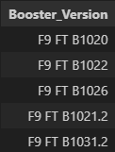
Successful Drone Ship Landing with Payload between 4000 and 6000
names of boosters which have successfully landed on drone ship and had payload mass greater than 4000 but less than 6000
SELECT DISTINCT Booster_Version FROM SPACEXTABLE WHERE PAYLOAD_MASS__KG_ BETWEEN 4000 AND 6000 AND Landing_Outcome like '%drone%' and Mission_Outcome = 'Success’

Slide 30
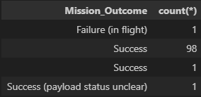
Total Number of Successful and Failure Mission Outcomes
total number of successful and failure mission outcomes
select Mission_Outcome, count(*) from SPACEXTABLE group by Mission_Outcome

Slide 31
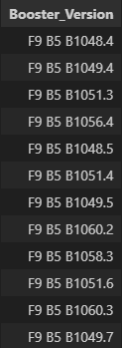
Boosters Carried Maximum Payload
Names of the booster which have carried the maximum payload mass
SELECT DISTINCT Booster_Version from spacextable where PAYLOAD_MASS__KG_ = (select max(PAYLOAD_MASS__KG_) from spacextable)

Slide 32
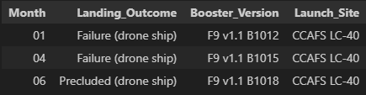
2015 Launch Records
List the failed landing_outcomes in drone ship, their booster versions, and launch site names for in year 2015
SELECT strftime('%m', Date) AS Month, Landing_Outcome, Booster_Version, Launch_Site
FROM SPACEXTABLE
WHERE strftime('%Y', Date) = '2015' and Landing_Outcome like '%drone%’;

Slide 33
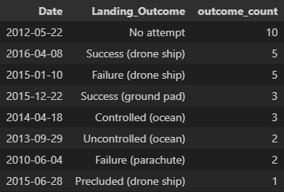
Rank Landing Outcomes Between 2010-06-04 and 2017-03-20
Rank the count of landing outcomes (such as Failure (drone ship) or Success (ground pad)) between the date 2010-06-04 and 2017-03-20, in descending order
select Date, Landing_Outcome, count(*) as outcome_count from spacextable where Date between '2010-06-04' and '2017-03-20' group by Landing_Outcome ORDER BY outcome_count DESC;

Slide 34

Section 3

Slide 35
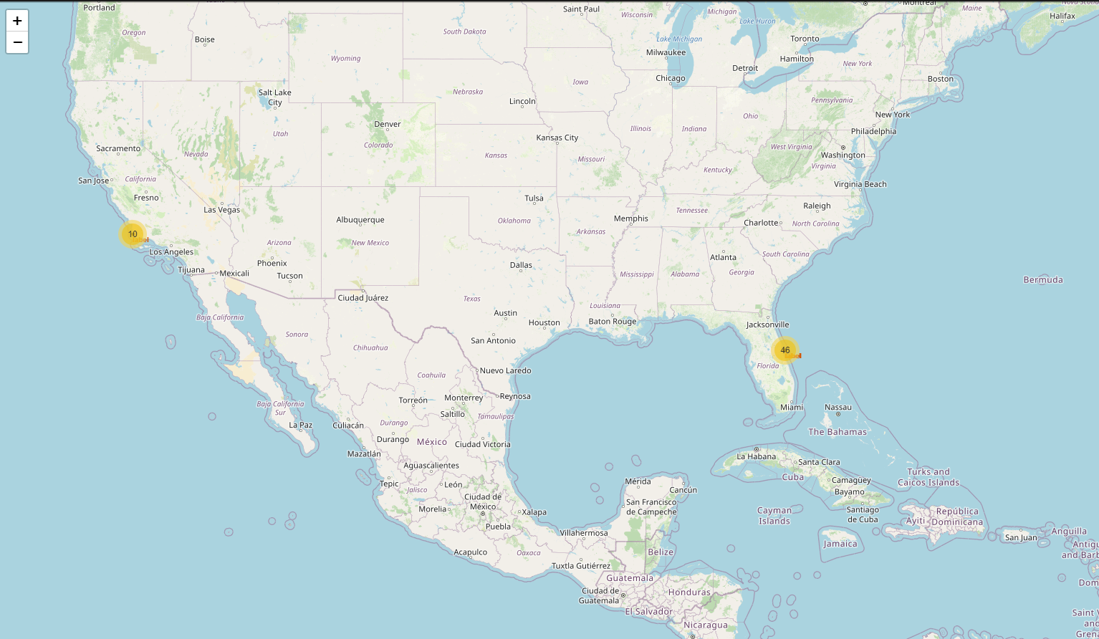
Launch sites positions and total launches
We can see where the different launches were performed in the map and the total, this is important allowing us to clearly identify the positions.

Slide 36
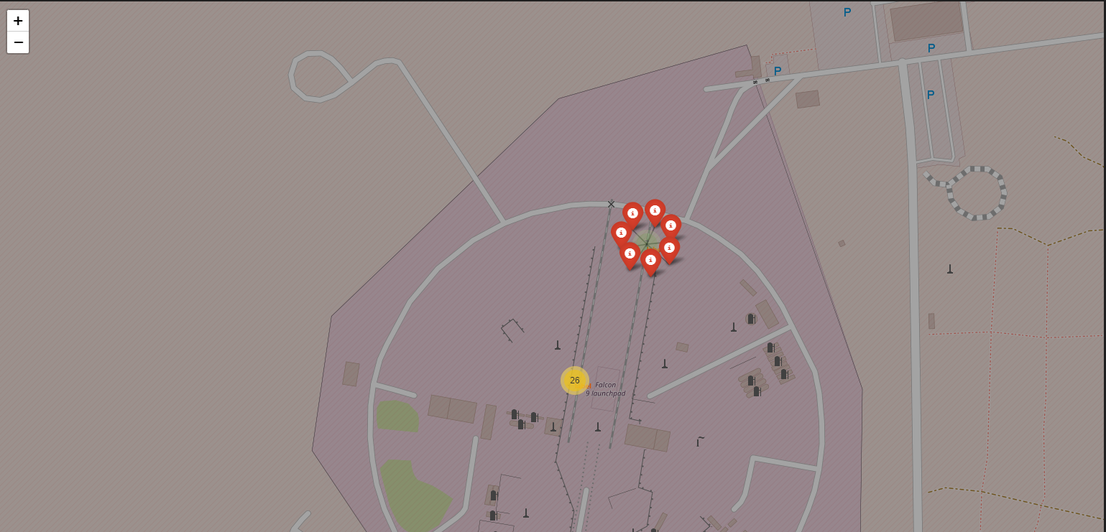
Folium Map for Class colored label outcome
We can see in the map in the different launch sites the success rate,
Red markers are failure outcomes and green ones are successful outcomes

Slide 37
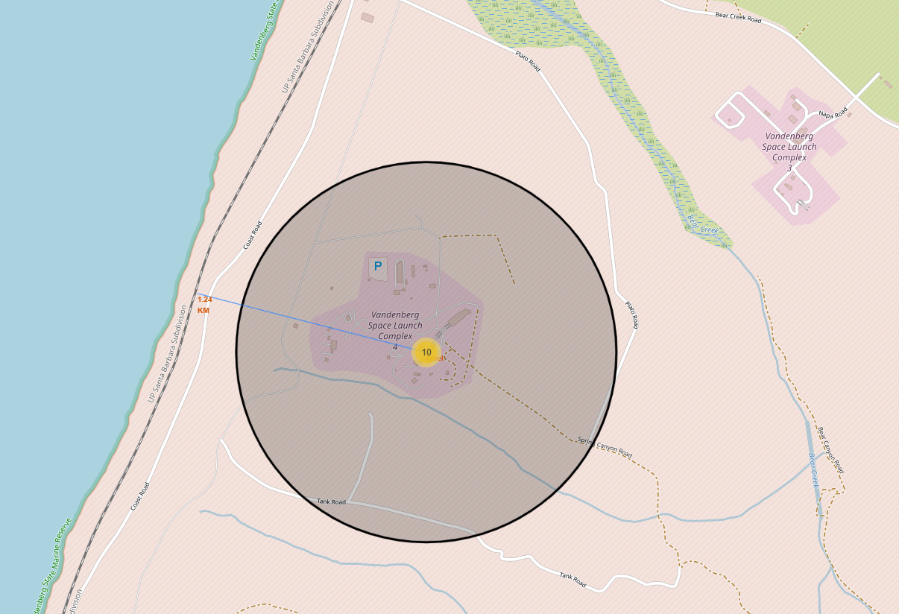
Launch proximities with highway
We can see launch sites are close to highways, this indicates that there’s no limitation for and specific area to chose the launch site when is about highways,
About cities is different
We can see that launch sites are always near the ocean and coasts

Slide 38

Section 4

Slide 39
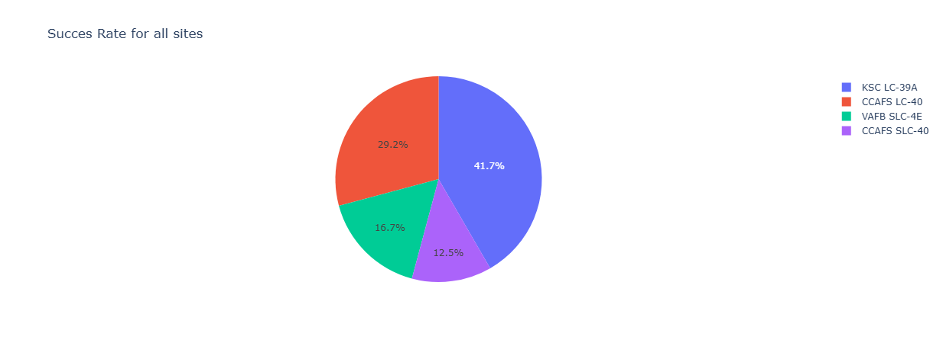
Launch success count for all sites
KSC LC-39A is the Launch site that shows a higher success rate compared to others,
The one with the smallest success rate is CCAFS SLC-40

Slide 40
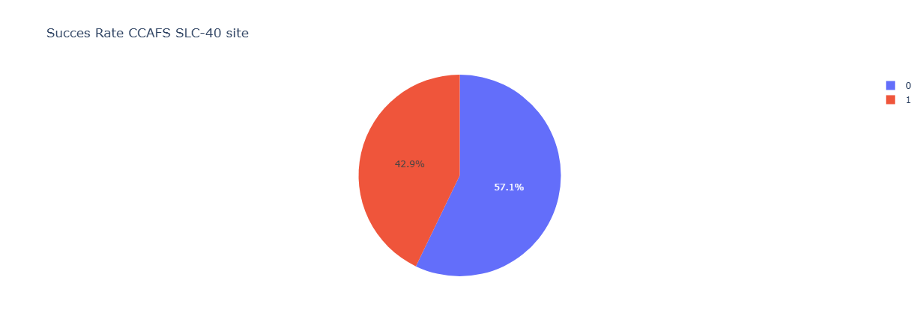
Success rate for CCAFS SLC-40 launch site
For CCAFS SLC-40 there’s a success rate of 42% being the launch site with the highest success rate

Slide 41
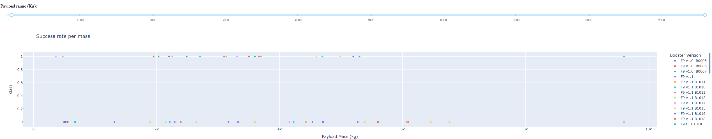
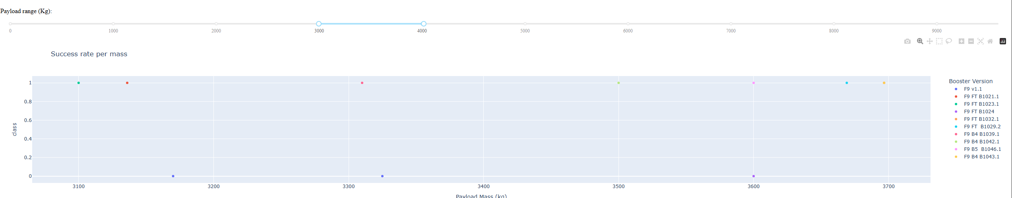
<Dashboard Screenshot 3>
The range with the highest success rate is between 3000 and 4000 kg of Payload Mass

Slide 42

Section 5

Slide 43
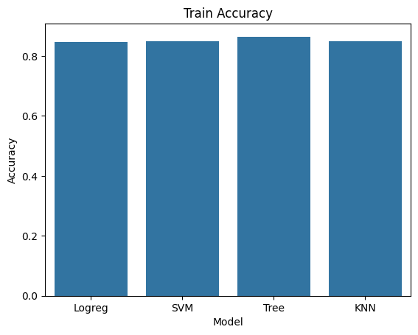
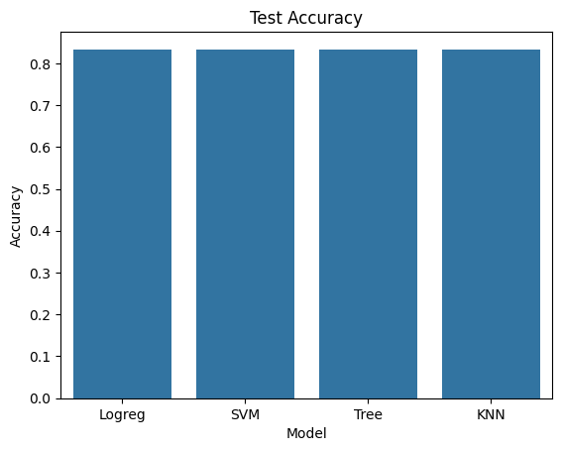
Classification Accuracy
Decision Tree is the model with highest accuracy

Slide 44

Confusion Matrix
The model shows a total number of misclassified outcomes of 3. It predicted that 3 launch landed well but it didn’t actually.
It correctly predicted that 12 launches were successful and 3 were not.

Slide 45
Conclusions
Point 1
The success or failure in the first stage of the launch is crucial for determining the cost of a lounch
Point 2
Data analysis allowed to identify patterns and relations between variables that allows us take the best decisions to reach the objectives
Point 3
Machine learning will allow to predict wheather the outcome of the selected features for a new lounch will be successful o a failure
Point 4
Data visualization make us gain more insights ina easy way from data showing the results with proven base
…

Slide 46
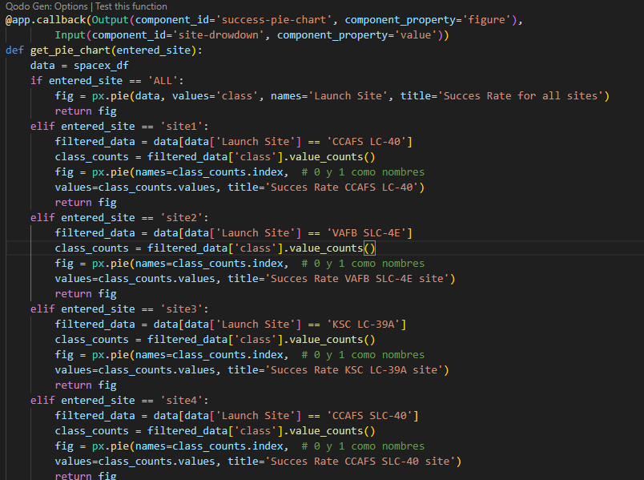
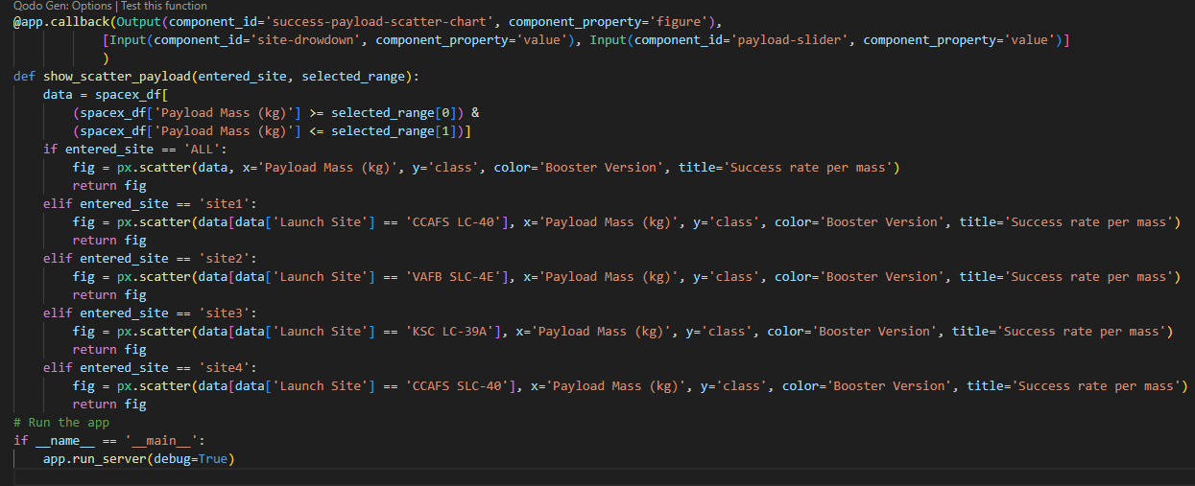
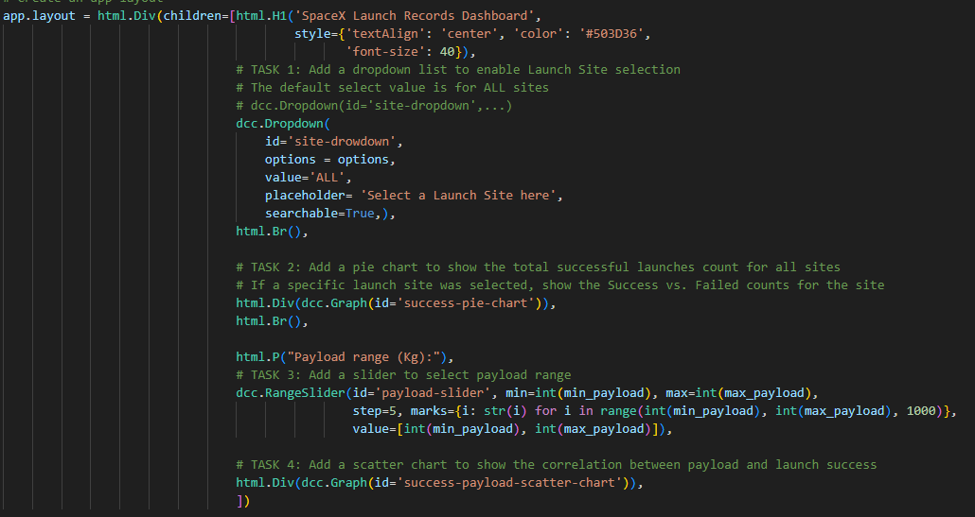
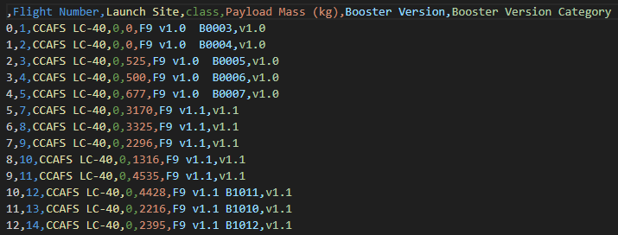
Appendix

Slide 47


